Slide 1
MTH1203: Probability and Statistics
Lecture 05 (BSCS, BSDS, BSIT)
Topic: Descriptive Statistics
Dr. Daphne Nyachaki Bitalo
Department of Computing & Technology
Faculty of Engineering, Design & Technology
Fri 6th Sept 2024

Slide 2
Lecture Objectives
The Objectives of this lecture are to:
Acquire skills in data cleaning, preprocessing, and exploratory data analysis.
Use statistical techniques to summarize and visualize data, including histograms, box plots, scatter plots, and other graphical representations.
Understand the importance of data quality and the impact of data biases on analysis results.

Slide 3
Lecture Overview
Data Collection and representation
Central Tendency
Data dispersion
Correlation and Covariation
Data visualisation

Slide 4
Descriptive statistics
Descriptive statistics is a branch of statistics that summarizes and describes data.
It provides a way to understand the key characteristics of a dataset, making it easier to draw conclusions and identify patterns.

Slide 5
Data collection and representation
Data Collection:
Gathering data from various sources, such as surveys, experiments, observations, or existing databases.
Primary data: Sourced firsthand or by oneself
Secondary data: Sourced by another
Data Representation: Organizing and presenting data in a clear and understandable format, often using tables, charts, or graphs. (Structured or unstructured)

Slide 6
Measures of central tendency
Mean: The average value of a dataset. (Imputes for missing data in a normally distributed continuous variable)
Median: The middle value in a dataset when it is arranged in order. (Imputes for missing data in a skewed continuous variable)
Mode: The most frequently occurring value in a dataset. (Imputes for missing data in categorical variable

Slide 7
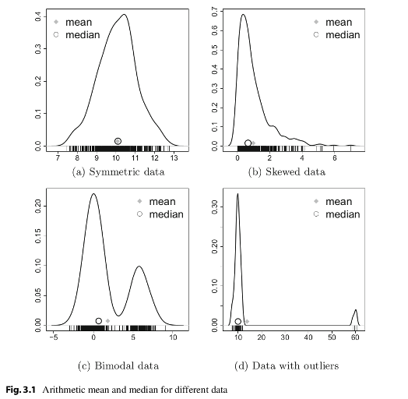
Measures of central tendency
These measures are also key in showing whether data is normally distributed or not

Slide 8
Measures of dispersion
These statistics measure how spread out the data is.
Variance: The average squared deviation from the mean.
Standard Deviation: The square root of the variance, providing a measure of dispersion in the same units as the data.
Interquartile range (IQR): The quartiles of data (spread out of data in quarters)
Range: Corresponds to biggest value minus the smallest value. It gives you the full spread of the data

Slide 9
Measures of dispersion
These statistics measure how spread out the data is.
Variance: The average squared deviation from the mean.
Standard Deviation: The square root of the variance, providing a measure of dispersion in the same units as the data.
Interquartile range (IQR): The quartiles of data (spread out of data in quarters)
Range: Corresponds to biggest value minus the smallest value. It gives you the full spread of the data

Slide 10
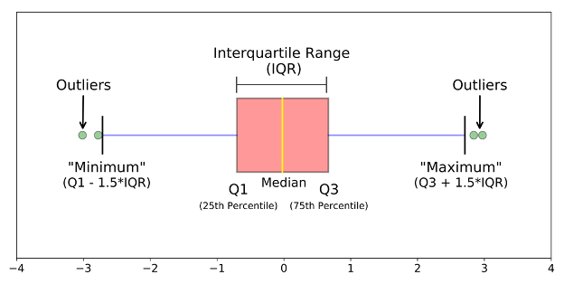
Defining the descriptive statistics
3. Interquartile Range (IQR)
Quartiles divide the data into 4 parts. IQR corresponds to the difference between the first and third quartiles - is sometimes used as a robust alternative to the standard deviation.

Slide 11
Purpose of each descriptive statistic
1. Range. It’s not often used because it’s very sensitive to outliers.
2. IQR. It’s pretty robust to outliers.
3. Variance. It’s completely uninterpretable because it doesn’t use the same units as the data. It’s almost never used
4. Standard deviation. This is the square root of the variance. It’s expressed in the same units as the data. The standard deviation is often used in the situation where the mean is the measure of central tendency.
5. Median. It’s a robust way to impute for missing data, for data with outliers. Used with continuous data that is not normally distributed.
6. Mode. Imputes for missing data that is categorical
7. Mean. Imputes for missing continuous data that is normally distributed

Slide 12
Testing for normal distribution
Rule of thumb:
Many of the statistical tests including correlation, regression, t-test, and analysis of variance (ANOVA) assume some certain characteristics about the data. They require the data to follow a normal distribution or Gaussian distribution. These tests are called parametric tests, because their validity depends on the distribution of the data.

Slide 13
Testing for normal distribution
So the distribution of data has to be testing using the following:
1. Visual inspection [normal plots (histogram), Q-Q plot (quantile-quantile plot)], boxplots)
2. Significance tests. Such as Shapiro-Wilk’s test (samples >3< 5000) and Kolmogorov-Smirnov (K-S) test (samples > 5000)
Data distribution also informs how missing data is handled

Slide 14
Correlation and Covariation
These statistics measure the relationship between two variables.
Correlation: A measure of the strength and direction of the linear relationship between two variables. It ranges from -1 to 1, where -1 indicates a perfect negative correlation, 1 indicates a perfect positive correlation, and 0 indicates no correlation.
Covariance: A measure of the joint variability of two variables. It is similar to correlation but is not standardized.

Slide 15
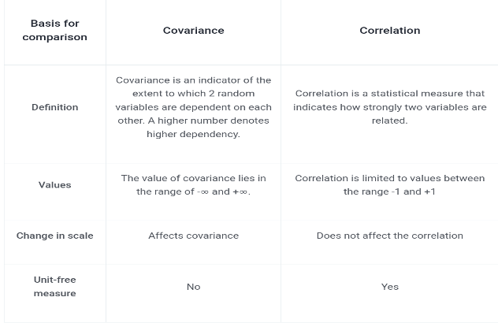
Correlation is NOT covariation

Slide 16
Data Visualisation
Visualizing data can help to identify patterns, trends, and relationships that might be difficult to see in numerical form.
Common types of charts:
Bar charts
Histograms
Line charts
Scatter plots
Pie charts

Slide 17
Practicum using python
1. Import the provided datasets in to visual studio (“Cassava_Yield_Data.xlsx” and “Bike_Sales.xlsx”)
2. Explore the datasets by identifying the data type of each variable.
3.. Describe the central tendency of two continuous variables.
4. Generate graphs to show the variability/dispersion on one continuous variable and one categorical variable.
5. Generate visuals to show the relationship between two continuous variables
6. Generate visuals to show the relationship between two categorical variables
7. Generate visuals to show the relationship between one continuous and one categorical variable
8. Generate statistical tests for questions 5-7 above.

